Slide 1






Managing Conflict in a Corporate Setting
Presented by: Krista Rosas
Extraco Banks

Slide 2

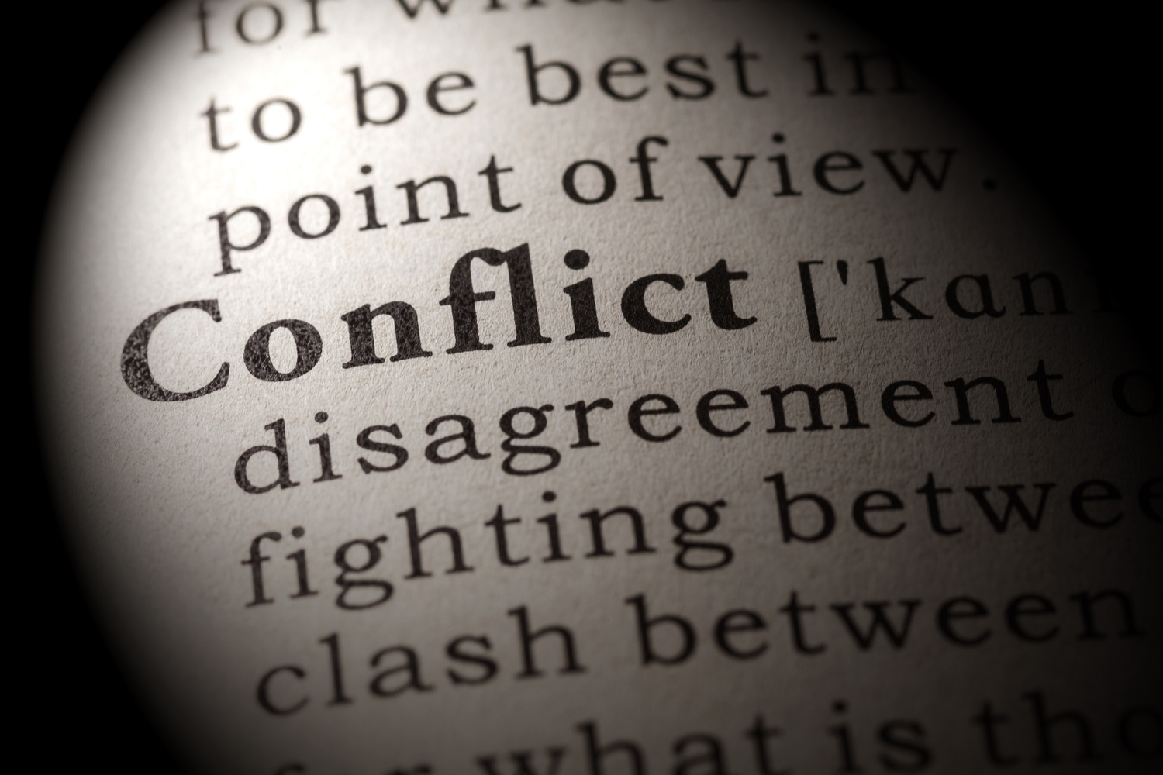


Definition of Conflict
A serious disagreement or argument, typically a protracted one, be incompatible or at variance; clash
Importance of Addressing Conflict in the Workplace
Addressing conflict in the workplace is essential for maintaining a positive and productive work environment, fostering strong relationships, and ensuring the long-term success of the organization. Effective conflict resolution strategies contribute to employee satisfaction, team cohesion, and overall organizational health.

Slide 3


Agenda
Types of Conflict in a Corporate Setting
Consequences of Unmanaged Conflict
Strategies for Conflict Resolution
Creating a Positive Conflict Resolution Culture
Tips for Preventing Conflict

Slide 4



Types of Conflict in a Corporate Setting
Interpersonal Conflict
Task Conflict
Role Conflict
  Differences in Communication Styles
  Personality Clashes
  Disagreements on Work Approaches
  Resource Allocation Disputes
  Ambiguity in Job Responsibilities
  Power Struggles

Slide 5






Consequences of Unmanaged Conflict
Negative Impact on Employee Morale
Increased Employee Turnover
Negative employee morale can lead to decreased productivity, strained team relationships, and increased absenteeism, all of which contribute to a decline in overall team performance. Additionally, it can result in higher turnover rates, disrupting team dynamics and causing the loss of valuable skills.
Increased employee turnover disrupts team stability, leading to a loss of institutional knowledge and skills. It also creates additional workload for remaining team members, impacting productivity and potentially hindering the achievement of team objectives.
Decreased Productivity
Damage to Organizational Reputation
Decreased productivity within a team results in delayed project timelines, compromised task completion, and an overall failure to meet goals efficiently. This can hinder the team's competitiveness, erode morale, and potentially impact the organization's bottom line.
Damage to organizational reputation negatively affects a company by eroding customer trust, potentially leading to decreased sales and business opportunities. Additionally, it can make it challenging to attract and retain top talent, impacting the company's competitiveness in the market.

Slide 6




Strategies for Conflict Resolution
Communication Skills
Mediation
Negotiation
Conflict Management Training
  Active Listening
  Effective Expression of Ideas
  Neutral Third Party
  Open Facilitated Dialogue
  Finding a Common Ground
  Win-Win Solutions
  Employee Wokshops
  Skill Building Programs

Slide 7









Creating a Positive Conflict Resolution Culture
Setting a Positive Example
Consistent Enforcement
  Effective Communication
  Recognition and Suipport
  Lead by Example
  Attendance Policies
  Performance Reviews
  Code of Conduct
Encouraging Open Communication
Team Building Activities
  Regular team meetings
  Feedback channels
  Accessibility to leadership
  Outdoor Adventure Challenge
  Escape Rooms
  Volunteer Intiatives
Clearly Defined Procedures
Encouraging Cross Functional Collaboration
  Onboarding Process
  Project Mangement Guidelines
  Conflict Resoltion Protocols
  Interdepartmental workshops
  Cross functional Project Teams
  Regular cross functional meetings

Slide 8

Tips for Preventing Conflict
Proactive Communication
Clarifying Roles and Expectations
Team Building Initiatives
Regular Checkins and Feedback Sessions

Slide 9




Feel Free to Reach out!
254.495.7644
Krosas@extracobanks.com

