Slide 1
The Enneagram: A tool for Reflective Leadership
Jon Singletary, PhD, MSW, Mdiv
Dean, Garland School of Social Work

Slide 2
Questions we will ask:
Can you understand yourself in terms of your capacity for thinking, feeling, and doing?
Which of these is dominant in your personality? At the level of the subconscious or unconscious?
Can you seek to balance thinking, feeling, and doing in your life?
How do these traits (and your number) nurture reflective leadership?

Slide 3
characteristics of human being
feeling –
emotional, affective, connection
thinking –
mental, cognitive, analysis
doing –
physical, instinctive, action

Slide 4
HEART - feeling
Awareness of others’ needs and agendas
Awareness of our own needs and agendas
Emotional responses

Slide 5
HEAD - Thinking
Logical reasoning
Planning, evaluating, analyzing
Gathering and sorting information
Making plans

Slide 6
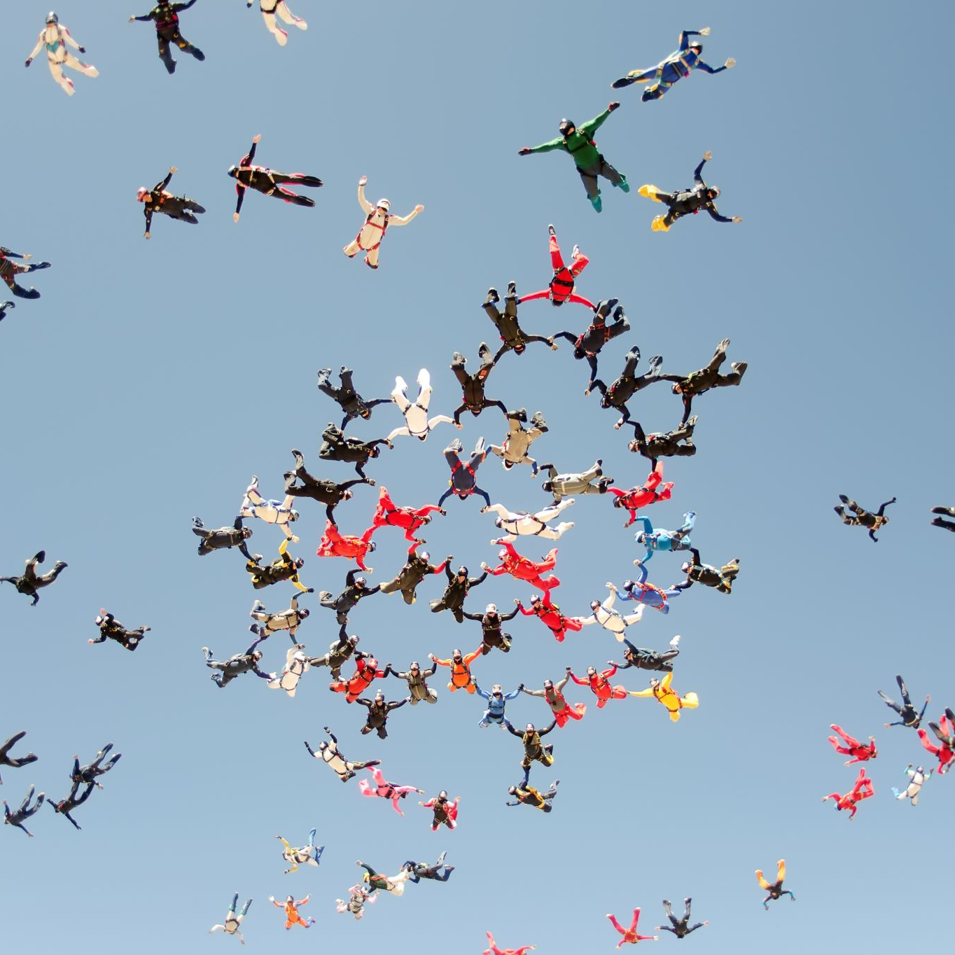
GUT/BODY/HAND - Doing
Accomplishing tasks
Pleasure seeking
Instinctive, physical responses to daily situations

Slide 7
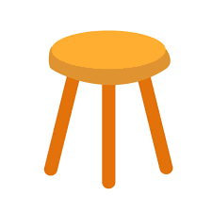
Three Legged Stool
How well do you balance
the 3 dimensions?
Not as well as
you might hope
or imagine!

Slide 8
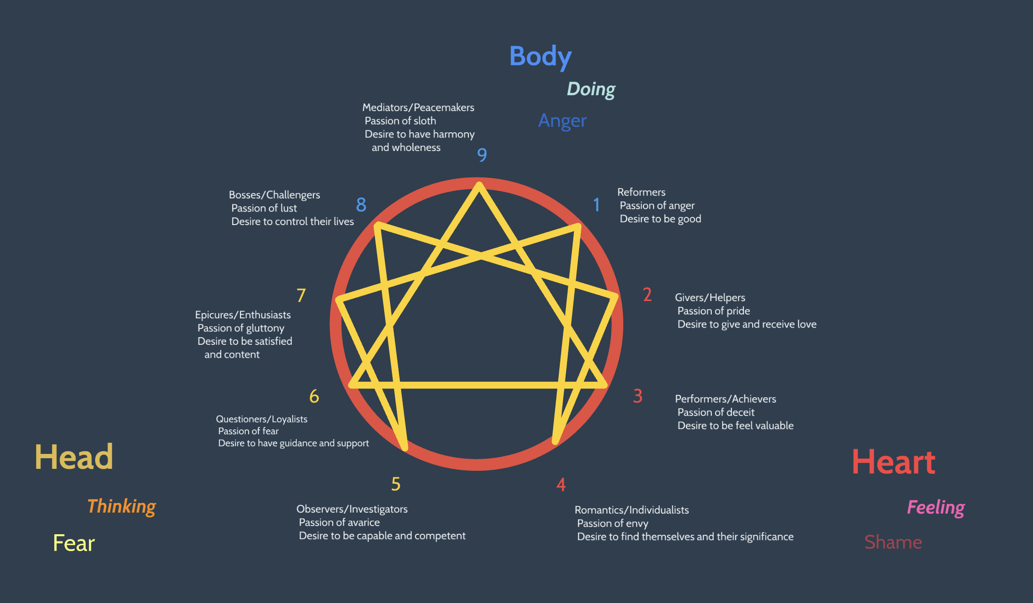
Enneagram Triads
The Enneagram triads are three groupings based on the assumption that some of us lead predominantly driven by feeling, some by thinking, and some by doing.
In other words, some lead from the heart, some with the head, and some by our hands.

Slide 13
How to nurture reflection?
Listen
Breathe deep
Observe
Non-judgemental self-observation
Allow
You cannot force change

